Slide 1
U.S. Construction Spending, by Value and Category, 2002-16
Springboard
John Wu

Slide 2
Data and Methods
The Value of Construction Put in Place Survey provides monthly estimates of the total dollar value of construction work done in the U.S. The survey covers construction work done each month on new structures or improvements to existing structures for private and public sectors. Data provided by Enigma.io from the U.S. Department of Commerce.
Provided by Tableau’s sample datasets: https://public.tableau.com/app/learn/sample-data
Tableau was used to generate the graphs.
Some python was used to look at the numbers.

Slide 3
Questions
The time span we are looking at has two major back-to-back presidencies of different parties? How did that affect construction spending?
How does this spending change over time as we reach the second term of each president?
How did the 2008 financial crisis affect construction spending?
How do public vs private spending compare? Residential vs Non-residential?

Slide 4
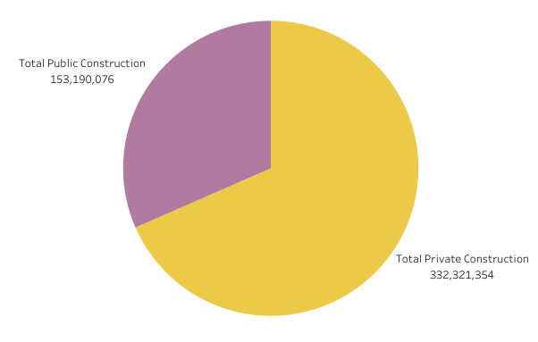
Public Vs Private Spending

Slide 5
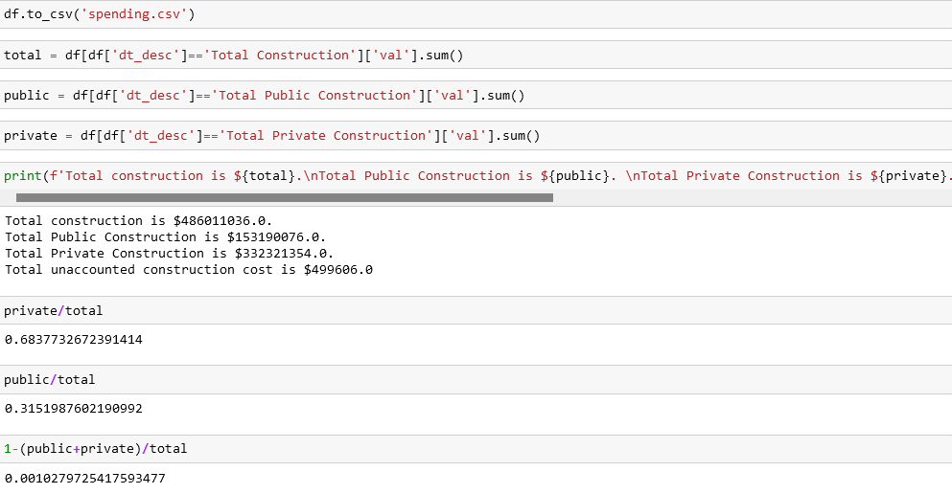
Ratio of public and private spending

Slide 6
Private vs Public Spending
Total construction is $486,011,036.
Total Public Construction is $153,190,076 (31%).
Total Private Construction is $332,321,354 (68%).
Total unaccounted construction cost is $499606 (0.1%)
Notes: Residential construction is under private, so it makes sense that more spending is done there. The US is also a capitalist society that prefers smaller government, so having private be more than twice as much as public also makes sense.
It is worth noting how big a single billion dollar is, given this is over the span of 14 years.

Slide 7
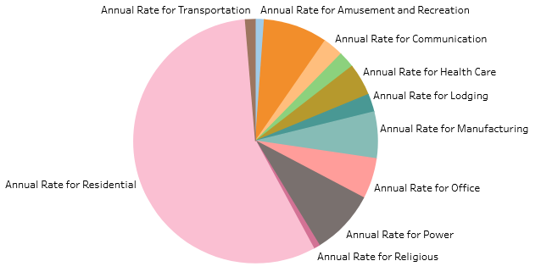
Private Spending

Slide 8
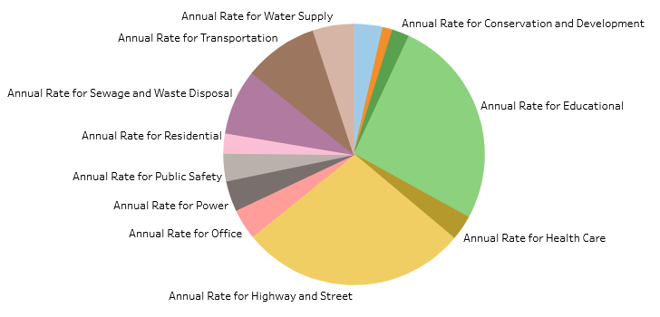
Public Spending

Slide 9
More notes on private and public spending
Top 3 for private: Residential, Commercial, Power
Residential is almost 7x more than the next top spending
Top 3 for public: Highways/Streets, Education, Public Transportation
Top 2 are close in spending, but are more than 3x that of spending on Public Transportation

Slide 10
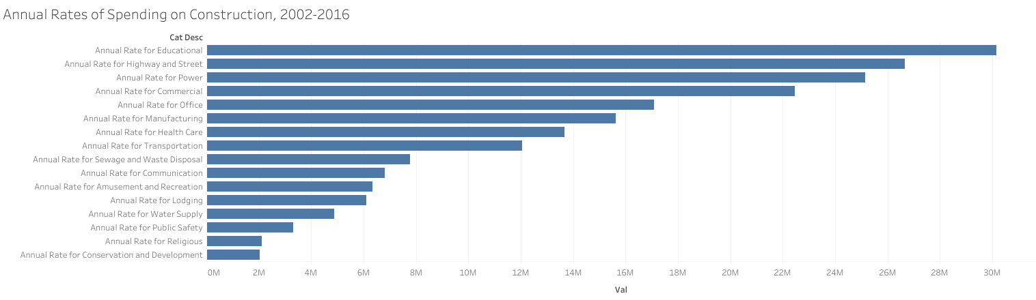
Above is non-residential construction spending.
When adding private and public power utilities, it comes close to the 2nd highest construction (highway/street).
Adding commercial and office construction far exceeds education.
What would be good to know:
How is education is split between higher, primary/secondary education?
How do utilities in other countries compare to the US, which has a relatively large expanse of land?

Slide 11
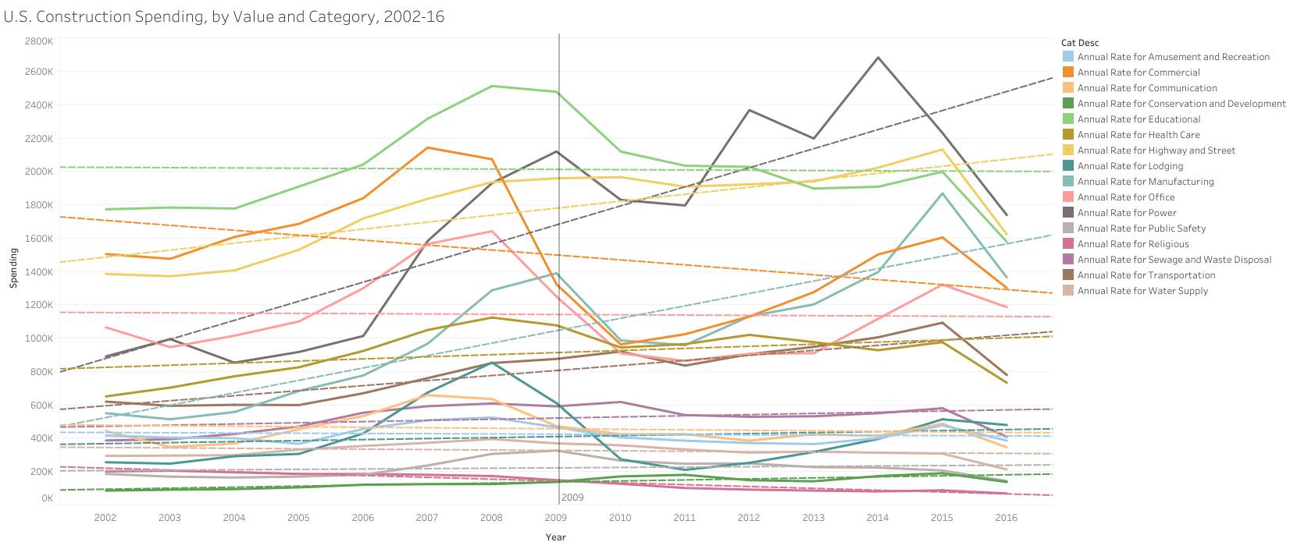

Slide 12
Trends
The line represents the start of Obama’s presidency after 2 terms of Bush. Residential construction is more than 3x the highest next highest spending, so it is omitted.
It took a little bit of time for the 2008 financial crisis to hit construction spending projects but spending overall drops dramatically and only starts to make a recovery around 2014. However, certain increasing trends still increased like Power and Highway/Street.
Top 3 trending up: Power, Manufacturing, Highway/Street
Some down trends: Commercial, Religious, Educations
Top peaks during Bush era: Educational, Commercial, Office, Lodging
Top peaks during Obama era: Power, Highway/Street, Manufacturing, Public Transportation

